Slide 1

Emotional Analysis & Evaluation of Pros and Cons Regarding Students 'Activities
----Based on Comprehensive Education Evaluation System in Tsinghua University High School
Zhaoyang Tian

Slide 2
Date: 05/23/2019
Presenter: Zhaoyang Tian

Slide 3
Contents
1
Introduction
2
Data Extraction
3
JIEBA Word Segmentation
4
WORDCLOUD
5
Emotional Evaluation
6
Supporting Vector Machine
7
Evaluation of Pros & Cons
8
Conclusion

Slide 4
Introduction

Slide 5
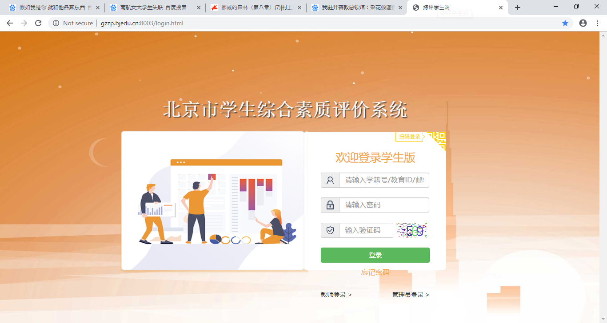
Introduction

Slide 6
Introduction
Transform the enrollment system to comprehensive-quality-oriented.
Concentrate on the all-round developments of students
Students can voluntarily upload the photos and text descriptions which reveal their special activities and strength that cannot be reflected by scores.

Slide 7
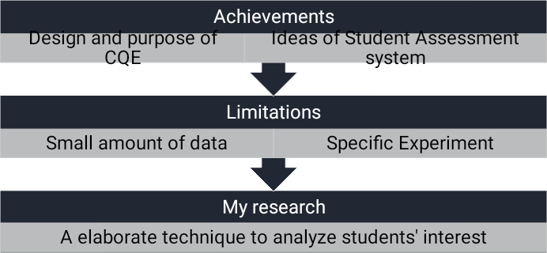
Introduction

Slide 8
Introduction
To demonstrate the data set in a brand new manner.
To evaluate the positive and negative feelings behind the data.
To screen the most popular activities among high school students.
To evaluate the pros & cons of the popular activities.

Slide 9
Introduction
End
Beginning
Conclusion
JIEBA Segmentation
Supporting Vector Machine
Word Frequency Analysis
SnowNLP
Original Emotional Analysis
WORDCLOUD

Slide 10
Data Extraction

Slide 11
Data Extraction
Data in the CQE system of G17(02/2018-06/2018) in Tsinghua University High School
Activities:
  Sports
  Innovation
  Oversea Study
  Club Events
  Arts

Slide 12
JIEBA Word Segmentation

Slide 13
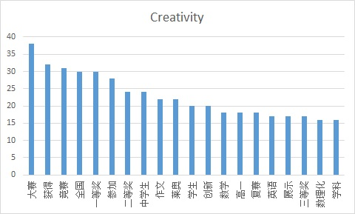
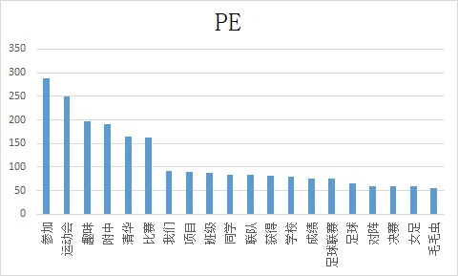
JIEBA Word Segmentation
Divide sentences into separate words
Word frequency analysis with stopwords

Slide 14
WORDCLOUD

Slide 15
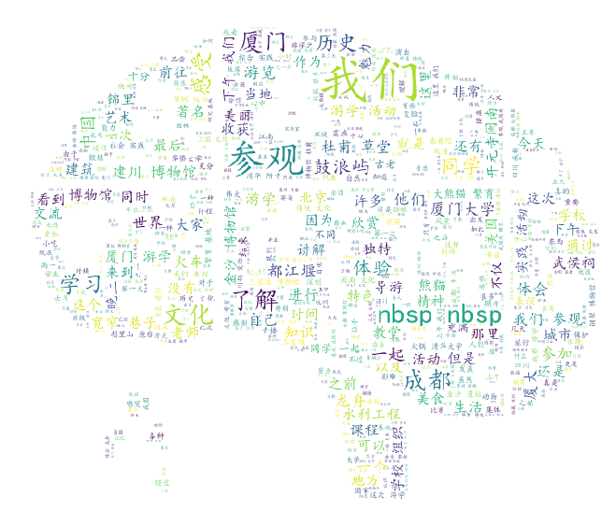
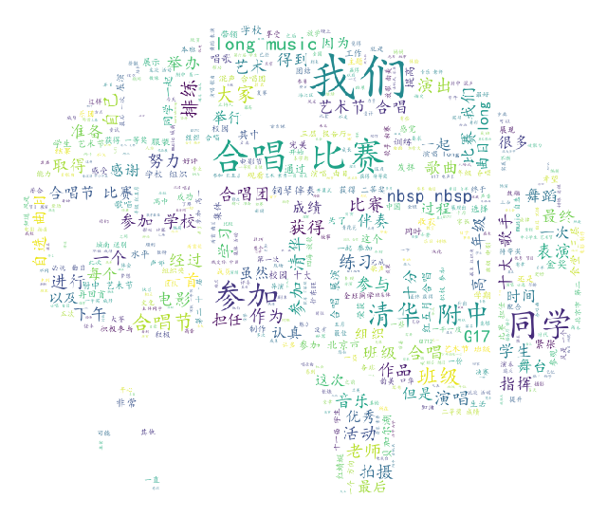
JIEBA Word Segmentation
WORDCLOUD module
Generate wordclouds through set of parameters

Slide 16
Emotional Evaluation

Slide 17
Emotional Analysis
End
Number of reverse words
Beginning
Cross-test
Number of exclamation marks
Enumeration of word lists
Score of a paragraph
Weight
Preparation of the data
Number of Degree words
4
Score of a single sentence
2
Number of Negative words
0.5
Number of Positive words

Slide 18
Supporting Vector Machine

Slide 19
Supporting Vector Machine
华侨大学 | 15
大熊猫 | 25
四川 | 20
川剧 | 15
变脸 | 11
辩论 | 20
模联 | 34
艺术节 | 12
明哲 | 7
李宁杯 | 7
电影 | 13
电视台 | 6
合唱节 | 16
艺术节 | 18
合唱 | 198
运动会
249
足球
66
篮球
31
Extract keywords
数理化
16
创新英语
17
高研
13
力学
13
厦门
84
成都
79
都江堰
36
武侯祠
34
龙舟
31
草堂
27
宽窄
23

Slide 20
Evaluation of Pros & Cons

Slide 21
Evaluation of Pros & Cons
Search the data which contains the keywords of popular activities
Find the positive and negative aspects of the activities

Slide 22
Conclusion

Slide 23
Conclusion
“Nervous”(紧张) : treated as negative in sports activities
Too less words in a piece of data: a negative one
“Visit”(参观), “observe”(观察): negative/ “participate”(参加), “involvement”(体验): positive
Data related to activities such as innovation, oversea study, arts, etc. are very likely to be viewed as positive.
Data about description is more likely to be viewed as positive than the narrative one.

Slide 24

[1] https://gzzp.bjedu.cn, Comprehensive Quality Evaluation Platform for Beijing General High School Students [EB/OL].
[2] Ze L., Reflections on the Evaluation of Comprehensive Quality in the Reform of College Entrance Examination [J], Contemporary Educational Science, 2017(4): 32-36, 45.
[3] Bingbing X., From Comprehensive Quality Assessment to Key Competencies Assessment----Research on the Transition of Student Assessment in High School [D]. Shanghai, China: East China Normal University, 2016.
[4] Zhaohui C., Study on Implementation of Senior High School students' Comprehensive Quality Assessment [D]. Zhengzhou, China: Henan University, 2016.
Bibliography

Slide 25
[5] Huoyun C. Zheng K., Research on Comprehensive Quality Evaluation of Senior High School Students [J], Global Education, 2010(9): 3-8,12.
[6] Jing W. Xi J. Dong L., Evaluation of Students’ Comprehensive Quality with the Aim of Promoting Development—The Concept and Practice of the Construction of the Second Class Transcript [J], Learning Resource and Technology, 2018(9).
[7] Xiaoming W. Nianjin D., History and Evolution of Ten Years Reform of the Comprehensive Quality Evaluation of Students in General Senior High School [J], Modern Education and Management, 2015(11): 74-79.
[8] Zhijun L. Hongxia Z., Evaluation on Senior High School Students Comprehensive Quality: Reality, Problem and Prospect [J], Curriculum, Teaching Material and Method, 33(1): 18-23.
[9] Long C., The Difficulty and Breakthrough of "Hard Link" between Comprehensive Quality Evaluation and College Enrollment [J], Journal of The Chinese Society of Education, 2017(7): 19-23.
[10] Dianjun W. Hui J. Weidong Meng. The High School Attached to Tsinghua University, Development and Application of the Comprehensive Student Quality Evaluation System Based on Big Data: Innovative Practice of the High School Attached to Tsinghua University [J], Chinese Examinations, 2018(1): 46-52, 66.
[11] https://blog.csdn.net/daniel\_ustc/article/details/48195287, Source Code Analysis of Chinese Word Segmentation in JIEBA Module [EB/OL].
[12] https://www.cnblogs.com/bymo/p/9334981.html, Keyword extraction based on WORDCLOUD Module: The use of wordcloud, source code analysis, generation of Chinese word cloud, and code rewriting [EB/OL].
[13] https://blog.csdn.net/google19890102/article/details/80091502, Emotional Analysis----Deepening the Principle and Practice of SnowNLP [EB/OL].
[14] https://blog.csdn.net/jzy3711/article/details/84760981, Positive and Negative Emotional Words [EB/OL].
[15] https://blog.csdn.net/qq\_16953611/article/details/82414129, Sklearn----SVM [EB/OL].
[16] Haiwei W. Yu X. Yalin W. A bivariate hierarchical Bayesian approach to predicting customer purchase behavior [J], Journal of Harbin Engineering University, 2007, 28(8): 949-954.

Slide 26
Thanks for your listening.
Date: 05/23/2019
Presenter: Zhaoyang Tian

